Slide 1


Meizheng Bio-Tech
Company Overview
en.meizhengbio.com
Committed to safeguarding global food health

Slide 2
CONTENTS
01
Company Overview
02
Food Safety Rapid Test
03
Microbiology Test
04
Laboratory Test

Slide 3

01
Company Overview

Slide 4


PerkinElmer at A Glance
HEADQUARTERS: WALTHAM, MA
EIGHT DECADES OF INNOVATION
MEMBER OF THE S&P 500
OPERATIONS IN OVER 190 COUNTRIES
28%
38%
34%
EUROPE
THE AMERICAS
ASIA PACIFIC
GLOBAL TECHNOLOGY LEADER
14,000 EMPLOYEES
$3.8 BILLION IN REVENUE
$12.5 BILLION ENTERPRISE VALUE
Notes:
Revenue % by region
PerkinElmer enables scientists, researchers and clinicians to address their most critical challenges across science and healthcare. With a mission focused on Innovating for a healthier world, we deliver unique solutions to serve the diagnostics, life sciences, food and applied markets. We strategically partner with customers to enable earlier and more accurate insights supported by deep market knowledge and technical expertise. Our dedicated team of about 14,000 employees worldwide is passionate about helping customers work to create healthier families, improve the quality of life, and sustain the well-being and longevity of people globally.

Slide 5





Meizheng Milestones
Established in 2007, Meizheng is one of the first Chinese companies to enter the food safety field.
HQ
2007
Huaan Magnech
2012
Meizheng Bio-Tech (Beijing)
2014
Meizheng Bio-Tech (Jiangsu)
2015
Meizheng Testing
2017
Meizheng Bio-Tech (Shandong)
2015
Overseas Business
In 2019 , Meizheng was incorporated into PerkinElmer
and further expanded overseas network since then.

Slide 6







Meizheng in China
EVERY YEAR
Processed Food
Dairy
We monitors the safety of
80 million tons of grain in China
We monitors the safety and quality of 6 million tons of raw milk in China
Grain & Feed
Seafood
We test the breeding and processing procedures of
16 million tons of livestock,
poultry and seafood in China
Vegetable & Fruit
Meat
No. 1 Market Share
in China (Rapid Test)
Notes:
Rapid Test of Instrument, Reagent and Pretreatment Solution
Meizheng provides rapid and precise test solutions in various industries, covering Grain & Feed, Dairy, Meat & Poultry, Seafood, Processed Food, Vegetables & Fruit, etc.

Slide 7







Global Footprint
UK
Harbin
Changchun
Urumchi
USA
Beijing
Rizhao
Xi’an
Wuxi
Changsha
Shanghai
Chengdu
Shenzhen
Production Center
R&D Center
Sales & Services
Multiple R&D labs in Beijing, Tianjin, Wuxi, Rizhao, and Qingdao
1 third-party testing lab, 4 plants, 5 tier 1 testing labs, 7 confirmatory labs

Slide 8

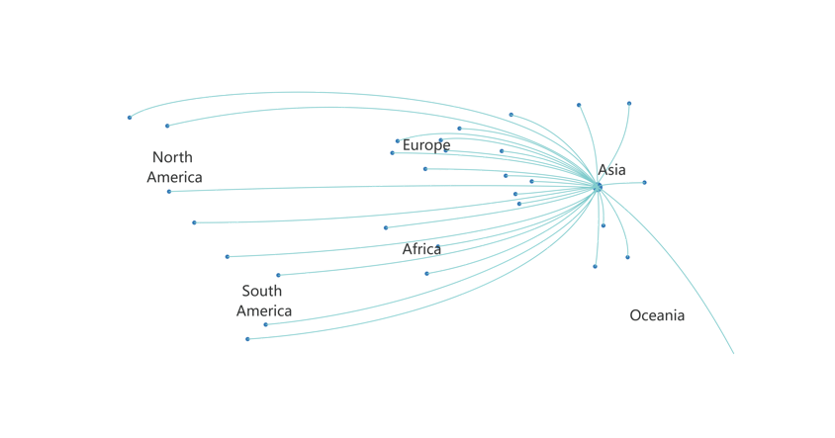






Overseas Sales Network
Expand to the overseas market since 2015
Provide test products and services in more than 50 countries
Sales network covers：
Asia: India, Korea, Japan, Singapore, Vietnam, Thailand, Indonesia, Pakistan, etc.
CIS: Russia, Belarus, Ukraine, Kazakhstan, etc.
ME: Israel, The United Arab Emirates, etc.
EU: UK, France, Italy, Germany, Turkey, etc.
North America: U.S., Canada, Mexico.
LATAM: Brazil, Argentina, Chile, Ecuador, etc.
Africa: Tunisia, Nigeria, Egypt, Morocco, etc.
Validation & Certification：

Slide 9
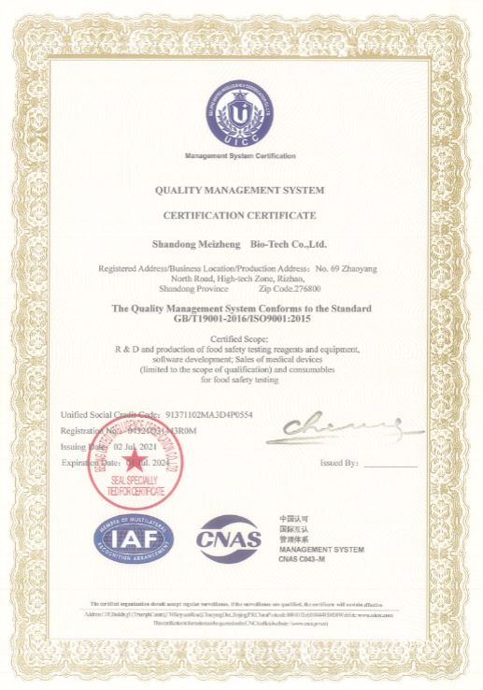
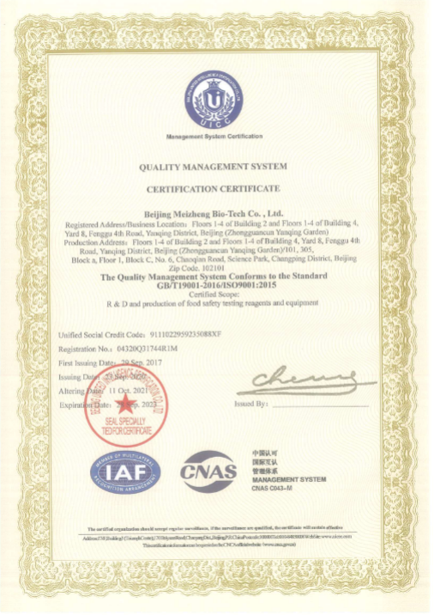
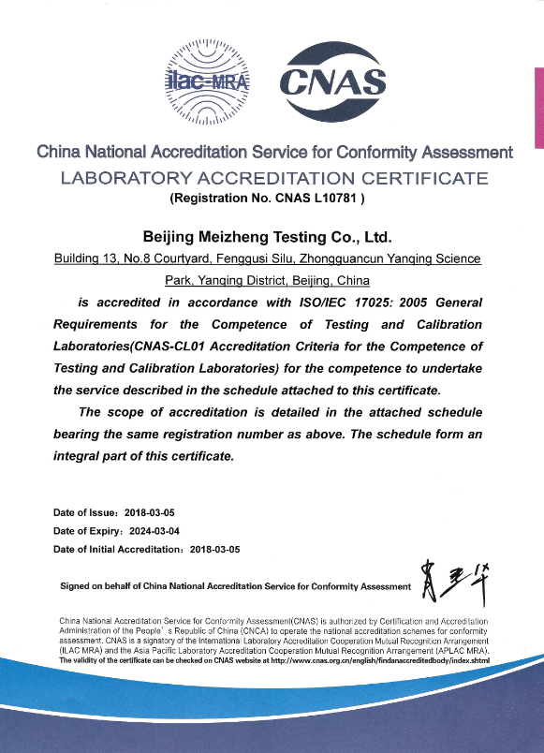
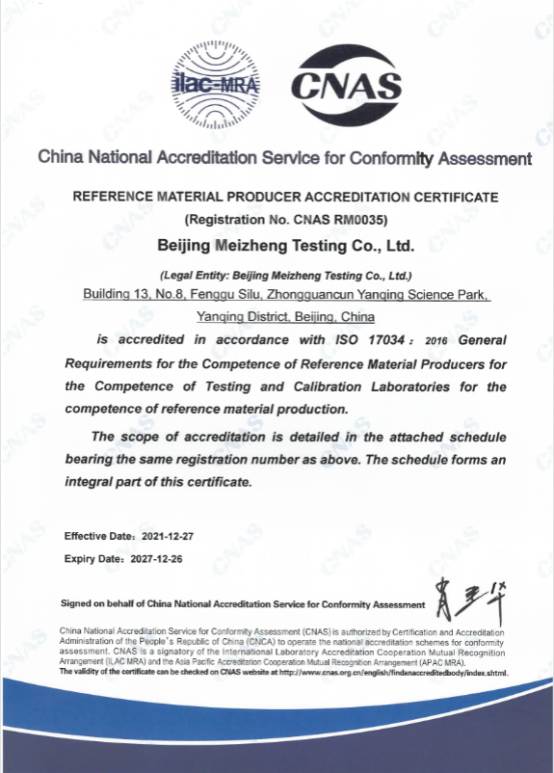
Scientific Research and Quality Management Input
5 R&D labs in Beijing, Tianjin, Wuxi, Rizhao and Qingdao, one is accredited with ISO17025. Some products are accredited with ISO17034 (i.e. certified RMP).
200+ Research staffs until 2022H1 with comprehensive background of biology, chemistry, instruments and software.
Manufactured in compliance with ISO9001 certified quality management system.
ISO
Meizheng participated in the revision of OTA ISO 15141:2018 international standard
80
Patents and software certificates
8
Core technologies
20
Scientific research projects
Notes:
RMP=Reference Material Producer

Slide 10
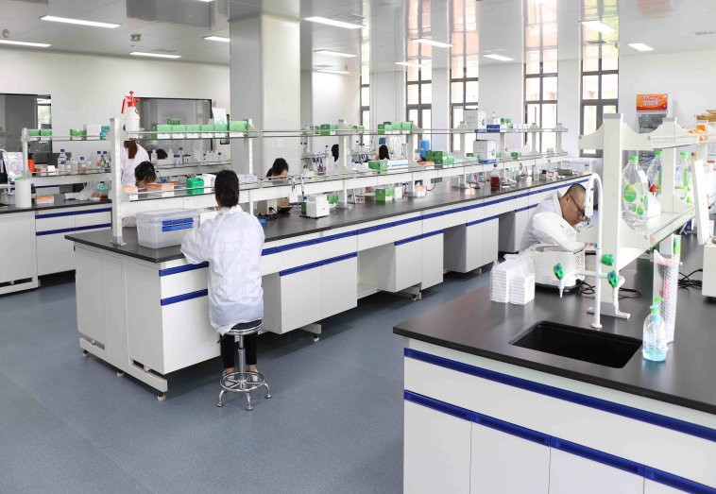
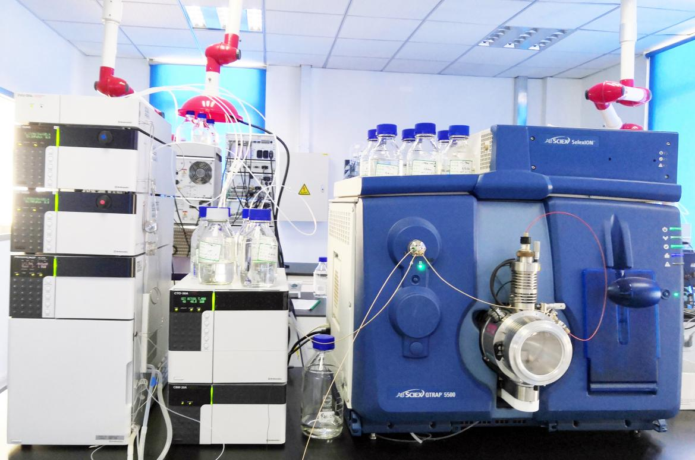
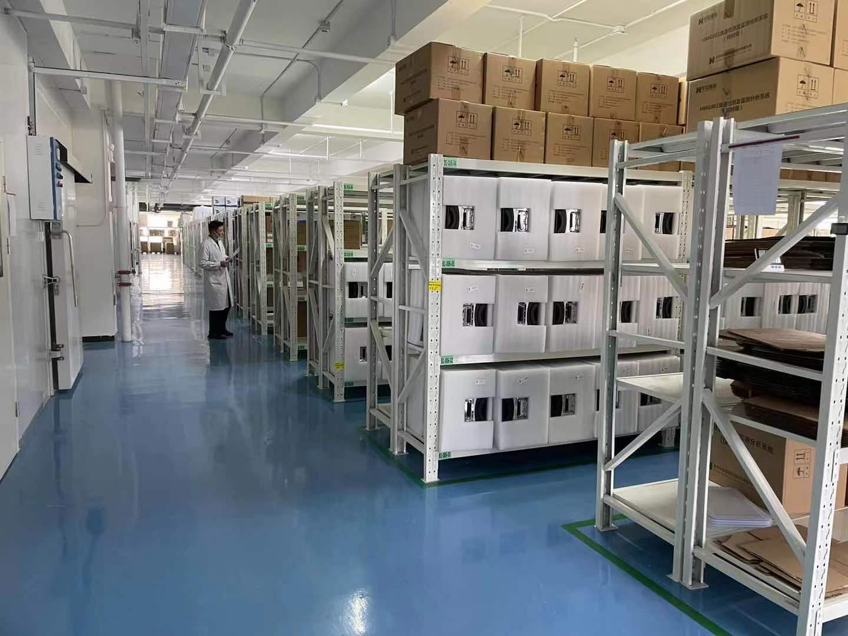
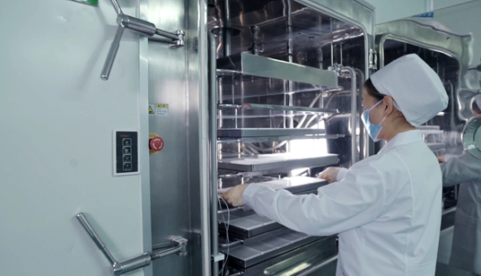
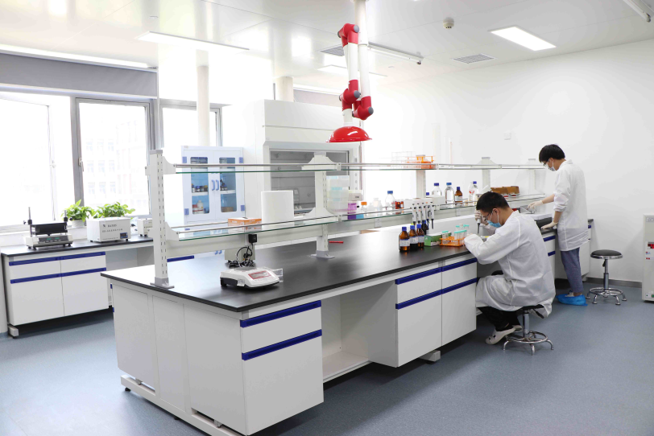
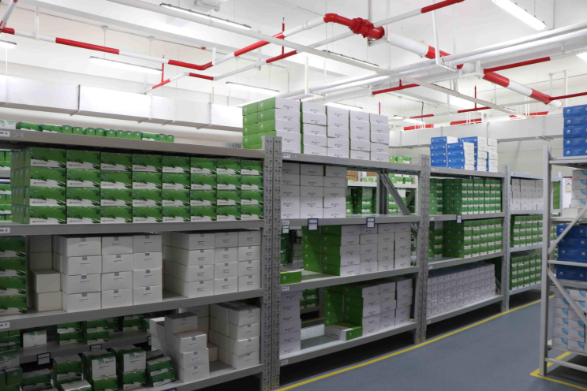
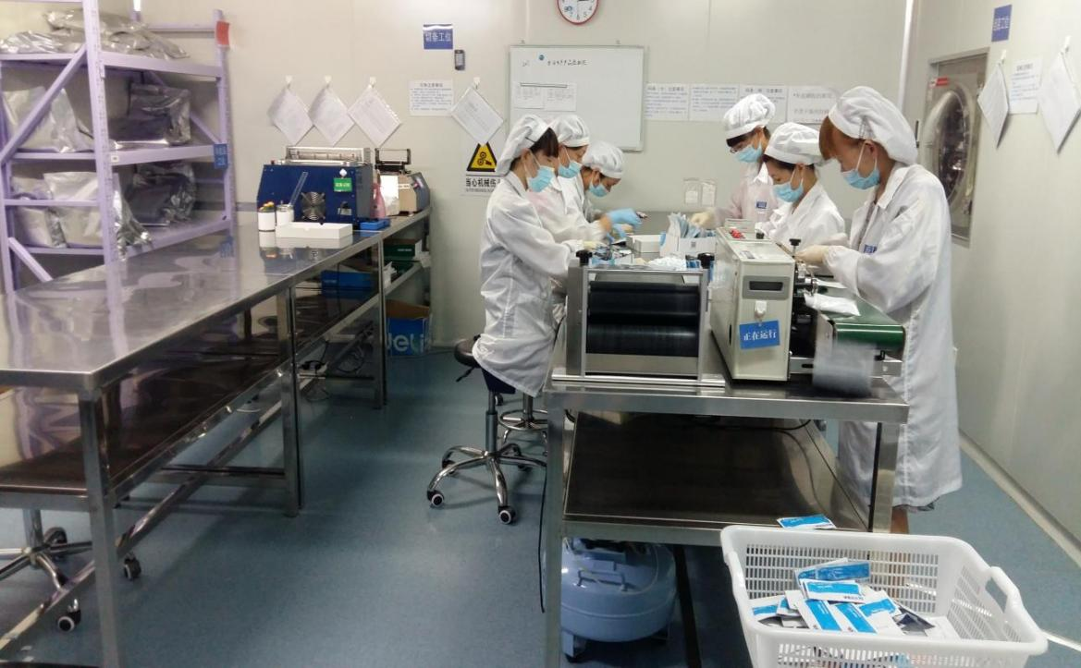
Scientific Research and Quality Management Input
R&D lab
Manufacture facilities
Logistic Management

Slide 11





















Technology & Service Platform
Provide integrated solutions from Rapid Test to Confirmation
Lateral Flow Test Platform
ELISA
Test Platform
Physicochemical
Test Platform
Microbiology
Test Platform
Lab Consumables Platform
Testing Service Platform

Slide 12
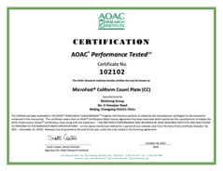
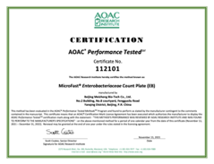
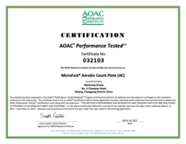
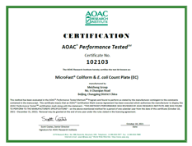
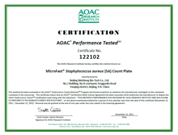
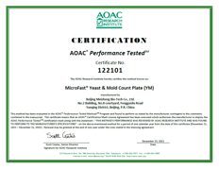
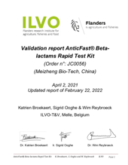
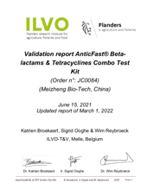
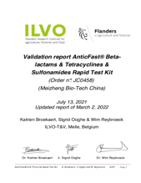
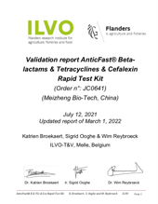
Validation Certificate/Report
Scientific research projects
Multiple international and domestic validations, qualifications and certifications acquired.

Slide 13









Food Safety Integrated Solution
Ensure Every Link of Food Safety From Farm to Table !
UPSTREAM
DOWNSTREAM
Supermarket/E-commerce
Planting
Food Processor
Distribution
Consumer
Raising/Fishing
Catering

Slide 14
Covering a Variety of Food Safety Areas
Items
Grain & Feed
Processed Food
Dairy
Seafood
Meat
Vegetable & Fruit
Biotoxin (mycotoxin, marine toxin, etc.)
✓
✓
✓
✓
✓
Microbiology
✓
✓
✓
✓
✓
Veterinary/Pesticides Residue
✓
✓
✓
✓
✓
✓
Unallowed Additives
✓
✓
✓
Nutrients
✓
✓
Heavy Metal
✓
✓
✓
✓
✓
Rapid Test Solution
Laboratory Test Solution
Notes:
Rapid Test of Instrument, Reagent and Pretreatment Solution

Slide 15



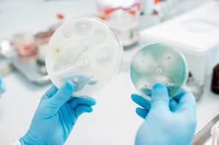

Three Business Segments
Food Safety Rapid Test
Microbiology Test
Laboratory Test

Slide 16

02
Food Safety Rapid Test

Slide 17




Industry
Grain
Feed
Honey
1
3
Dairy
Meat Poultry Seafood
Egg
2
4

Slide 18

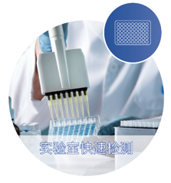
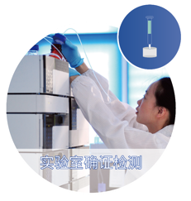






Grain/Feed
Meizheng can provide integrated test solution for clients in the field of Grain & Feed.
Field Rapid Test
Lab Rapid Test
Lab Confirmatory Test
Raw materials enter
the barn/feed mill
On-site grain collection
Production monitoring/
Inventory monitoring
Positive samples confirmation/
Supervision spot-check
Offer an integrated solution from Testing to Confirmation
Simple operation
On-site detection
High sensitivity Batch processing
International standard method
Confirmatory test

Slide 19




Grain/Feed
Sufficient test items
Covering 4 major indicators of grain safety: mycotoxins, heavy metals, pesticide residues and genetically modified organisms
Covering 3 risk indicators of feed safety: mycotoxin, antibiotics and illegal addition
Secured process
Convenient operation
Accurate results
Numerous test samples
Raw grain, finished grain, grain and oil products
Feed raw materials, feed finished products

Slide 20




Dairy
Meizheng can provide instruments, reagents, technical services for users in the dairy field.
Test items
Contaminants - Heavy metals, nitrites…
Mycotoxin - Aflatoxin M₁
Microbes - Aerobic bacterial count…
Pesticide residues - Carbendazim, imidacloprid…
Veterinary drug residues - Antibiotics, hormones…
Illegal additives--- Beta-lactamase, melamine…
Nutrients - Lactoferrin, lactalbumin, vitamins, IgG, lactoperoxidase…
Keeping up with changes in international standards to adjust detection items of pesticide residues and veterinary drug residues, including ELISA kit and colloidal gold rapid detection strip.
A variety of nutrient detection solutions are provided for laboratory detection, making the detection more accurate and convenient.

Slide 21





Feeding
The quality and safety of dairy products is controlled from the feed. The contamination of mycotoxins in the feed, especially AFB₁, directly affects the health of dairy cattle and the quality of dairy products. ToxinFast® Mycotoxin Test Kits are suitable for daily monitoring of mycotoxins in feed factories and ranches.
Strict process control
Detection of dairy semi-finished products and finished products need quantitative test results, various test kits and pretreatment column products can meet the demand of users, be convenient for analysis and provide basis for decision-making.
Dairy
Stock inspection in
milk collection
On-site milk collection needs simple and easy-to-use detection products to quickly determine aflatoxin M1, drug residues, hormones, heavy metals, illegal addition, adulteration and other substances in fresh milk. Colloidal gold Rapid Test Kits can effectively solve these problems.
Food supply chain
risk control
Hold the last pass of entering the dining table and provide efficient testing solutions for quality testing authority.
From farm to table, from feed to dairy products, from rapid screening to accurate confirmation, provide overall feed and dairy solutions.

Slide 22




Honey
Meizheng can provide rapid test solutions for users in the honey field.
Veterinary drug residues: Nitrofurans\trimethoprim, quinolones, sulfonamides, tetracyclines…
Lateral Flow Rapid Test Strip
ELISA Rapid Test Kit
Pesticide residues: Carbendazim, acetamiprid…
Batch samples, more convenient operation and more accurate results.

Slide 23









Meat/Poultry/Egg/Seafood
Meizheng can provide rapid test solutions for users in the meat/poultry/seafood/egg field.
Rapid Test Kit (colloidal gold)
ELISA Test Kit Kit
Raising/slaughter
Processing
Supplying
Provide feed hygiene and safety detection in the breeding process and drug residue detection scheme in the breeding process or before slaughtering for breeding/slaughtering enterprises, to improve the product quality and safety in the breeding/slaughtering step.
Provide drug residue detection schemes for raw materials and finished products for relevant processing enterprises, so as to ensure product quality and safety during processing.
Provide drug residue/illegal additives detection schemes for supermarkets, restaurants, markets and government regulators to ensure the quality and safety of products.
In the field of seafood product detection, it can provide biotoxin test schemes such as tetrodotoxin, shellfish toxin and microcystin.

Slide 24
Key Products
Catalogue # | Products Name | Remarks
JC0056 | Beta-lactams Rapid Test Kit | ILVO validated AOAC on-going
JC0084 | Beta-lactams & Tetracyclines Combo Test Kit | ILVO validated AOAC on-going
JC0458 | Beta-lactams & Tetracyclines & Sulfonamides Rapids Test Kit | ILVO validated AOAC on-going
JC0641 | Beta-lactams & Tetracyclines & Cefalexin Rapid Test Kit | ILVO validated HS with Cefalexin AOAC on-going
JC0208 | Beta-lactams & Tetracyclines & Chloramphenicol & Streptomycin Rapid Test Kit | ILVO on-going
JC0457 | Beta-Lactams & Tetracyclines & Sulfonamides & Fluoroquinolones Rapid Test Kit | ILVO on-going
JC0842 | Beta-lactams & Tetracyclines & Ceftiofur & Cefalexin Rapid Test Kit | ILVO on-going HS with Ceftiofur & Cefalexin
JC0874 | Aflatoxin M1 Qualitative Rapid Test Kit | Dual LODs Meet EU MRL
JC0282 | Melamine Rapid Test Kit | Featured Product Illegal Additives
JC0187 | Goat Milk Adulteration Rapid Test Kit | Featured Product Adulteration
ME30AER | Ractopamine ELISA Test Kit | AOAC on-going

Slide 25
Key Products
Catalogue # | Products Name | Remarks
LR50501 | Staphylococcus aureus Enterotoxin ELISA Test Kit | AOAC on-going Comply with EU sample pre-treatment method
WC0006 | DASH Test Kit | AOAC on-going High-throughput Can detect 60 antibiotics in raw milk at a time. Specially for a large volume on-site screening for farmers.
HEM1796 | Zearalenone ELISA Test Kit | AOAC on-going Fast reaction time with 20 minutes
HEM1896 | Deoxynivalenol ELISA Test Kit | AOAC on-going Fast reaction time with 20 minutes
HEM2596 | Aflatoxin B1 ELISA Test Kit | HS with variety formula food matrix, such as milk powder, rice flour, etc.
ME01AER | Chloramphenicol ELISA Test Kit | Various samples including meat, liver, eggs and seafood High sensitivity High sales in APEC and India
ME03AER | Furazolidone Metabolite ELISA Test Kit
ME04AER | Furaltadone Metabolite ELISA Test Kit
ME05AER | Furacilin Metabolite ELISA Test Kit
ME06AER | Furantoin Metabolite ELISA Test Kit

Slide 26

03
Microbiology Test

Slide 27









Meizheng can provide professional overall solutions for microbiology test for users.
Meizheng have been focusing on the research of rapid test and identification technology of microorganisms and their pathogenic factors, and have established rapid culture platform, immunoassay platform and molecular biology technology platform.
The application areas include:
Ranch, food processing and catering, as well as regulatory and scientific research institutions.
Bacteria
Virus
Bacterial toxin
Virulence gene
Ranch
Food processing
Restaurant
Supermarket& Convenience store

Slide 28







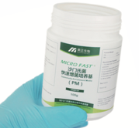
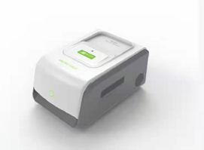



Microbial count plate
Real time PCR kits
Colloidal gold rapid test cassette
Rapid enrichment media
ATP hygiene monitoring system
Real time PCR kits and thermal cycler
Pre-enrichment
Rapid screening
Confirmation/Identification
Comprehensive microbiology testing solution enables detection of microbial contamination in the various food matrix

Slide 29



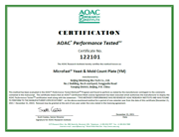


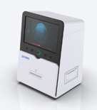
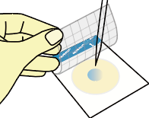

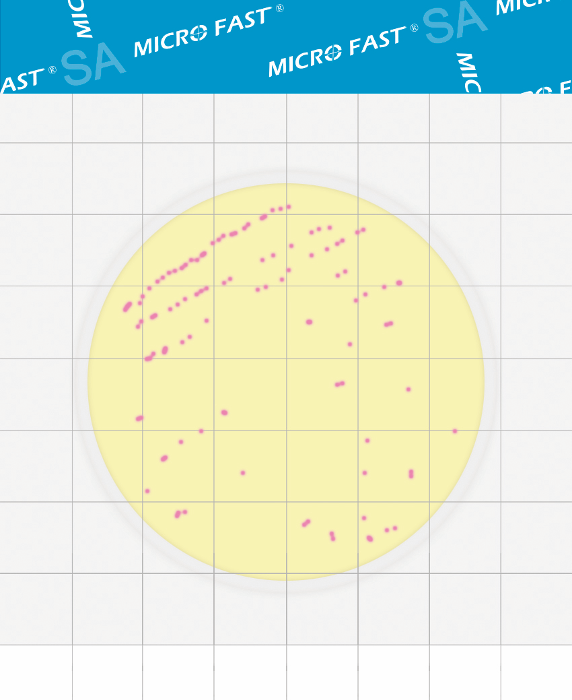
Pre-enrichment
Rapid screening
Confirmation/Identification
AOAC-PTM certificates acquired.
MicroFast® Microbial Count Plates deliver cost, time and space savings over traditional agar-based methods, while providing a cost effective, more sustainable alternative.
3 steps
procedure
Count Plate Reader Coming Soon!
Add sample
Culture
Interpret

Slide 30

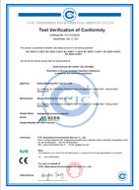
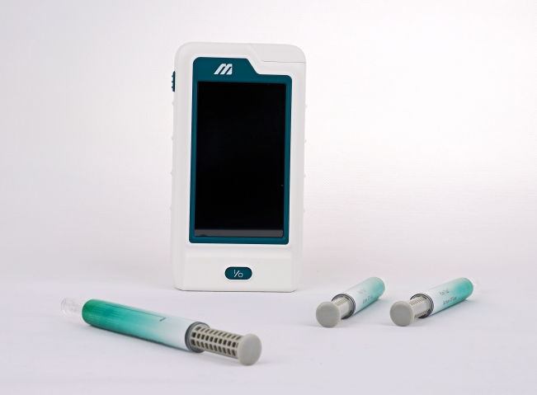
Pre-enrichment
Rapid screening
Confirmation/Identification
ATP Intelligent
Hygiene Monitoring System
PureTrustTM Intelligent Fluorescence Detector is a widely used indicator of environment hygiene. Hygiene monitoring through ATP detection can quickly obtain results and take immediate actions.
PureTrustTM Intelligent Fluorescence Detector has obtained CE certification.
PureTrustTM Surface Swab
Pre-moistened and ready to use

Slide 31
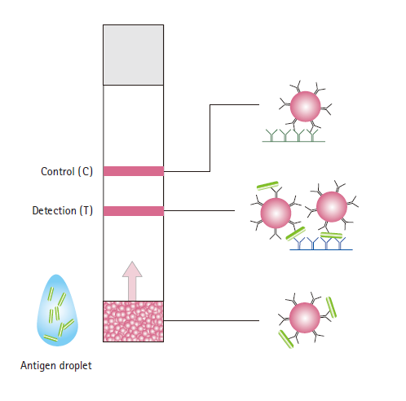
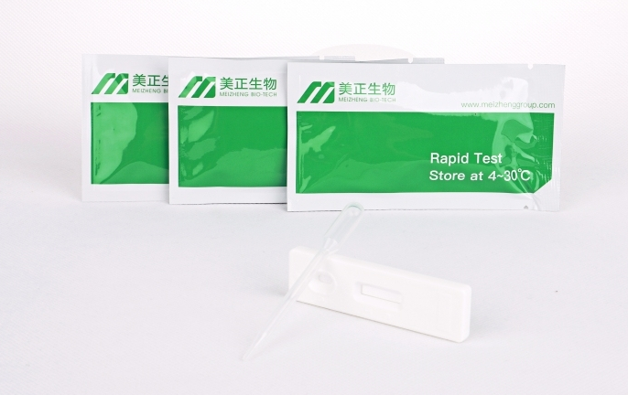
Pre-enrichment
Rapid screening
Confirmation/Identification
MicroFast Rapid Test Cassette (lateral flow) is designed to detect the pathogen in meat and dairy products,seafood and vegetable products, eggs,feedstuffs, as well as environmental samples.
Principle
8 minutes for detection
Simple Interpretation
Stable Performance
Notes:
This immunoassay test uses a double antibody sandwich format. An antibody specific for pathogen is sprayed in a line on the surface of a membrane comprising a “test line”. A second antibody reagent, also recognizing pathogen and labeled with colloidal gold, is contained within a reagent pad upstream from the test line. As the sample moves from the filter pad, the antibody gold reagent specifically binds pathogen and moves with the liquid sample into the test membrane. The sample passes through the test line where the immobilized second antibody captures the protein–antibody–gold complex, causing the formation of an antibody–protein “sandwich” and development of red color at the test line. Antibody–protein sandwiches are not formed in the absence of the pathogen, resulting in no red color development at the test line.

Slide 32
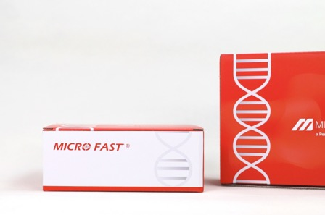
Pre-enrichment
Rapid screening
Confirmation/Identification
MicroFast® Real Time PCR provides specific primers and probes. PCR amplification is detected by Taqmanprobe which is degraded during PCR process and releases fluorophore. The PCR instrument generates theamplification curve according to the fluorescence signal intensity and qualitatively detect the target pathogens inthe sample.
AOAC validation of MicroFast® Real Time PCR Kit is in process.
96-well PCR Thermal Cycler Coming Soon!
MicroFast® Real Time PCR Kit are dried for optimal simplicity of use and uniformity of results.
Pre-packed lysis buffer and premixed solution are provided. No extra reagents required.

Slide 33
Key Products
Microbial count plate
Real time PCR kits
Catalogue # | Product Name
LR1001 | MicroFast® Aerobic Count Plate
LR1002 | MicroFast® Coliform Count Plate
LR1003 | MicroFast® Yeast & Mold Count Plate
LR1005 | MicroFast® Staphyloccocus aureus Count Plate
LR1007 | MicroFast® Coliform & E.coli Count Plate
LR1011 | MicroFast® Enterobacteriaceae Count Plate
Catalogue# | Products Name
LR70401F | MicroFast® Enterobacter sakazakii Real Time PCR kit
LR70601F | MicroFast® Salmonella Real Time PCR kit
LR707H1F | MicroFast® STEC Real Time PCR Kit
Rapid test cassette
Catalogue # | Products Name
LR20501 | MicroFast® Staphylococcus aureus Rapid Test Cassette
LR20601 | MicroFast® Salmonella Rapid Test Cassette
LR20701 | MicroFast® E.coli O157 Rapid Test Cassette
LR20801 | MicroFast® Listeria Rapid Test Cassette
ATP hygiene monitoring system
Catalogue# | Products Name
PTS100 | PureTrustTM Surface Swab
MF1000Premium | PureTrustTM Intelligent Fluorescence Detector

Slide 34

04
Laboratory Test

Slide 35
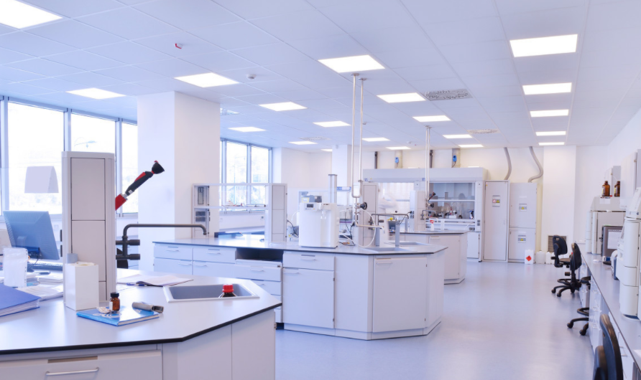
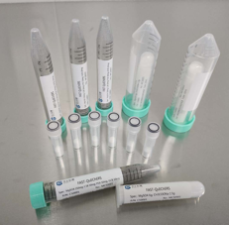
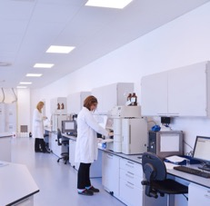
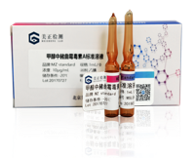
Laboratory Test
Provide high-quality reference materials, quality control materials, sample pretreatment instruments and consumables for laboratorian.
Combine products and services to provide total solutions for our customers based on the third-party testing service platform.
Pre-treatment
consumables & equipment
Reference Standards & Quality Control Materials
Third-party testing service
A wide range of pre-treatment consumables and equipment supports laboratorians in improving work efficiency and reducing experimental errors.
The high-quality reference standards and quality control materials are accurate to determine the value. The products pass the verification of homogeneity and stability to guarantee the quality.
Professional laboratory testing platform can provide better technical support for customers, and accurate testing technology can guarantee the high quality of products.

Slide 36
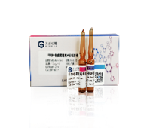
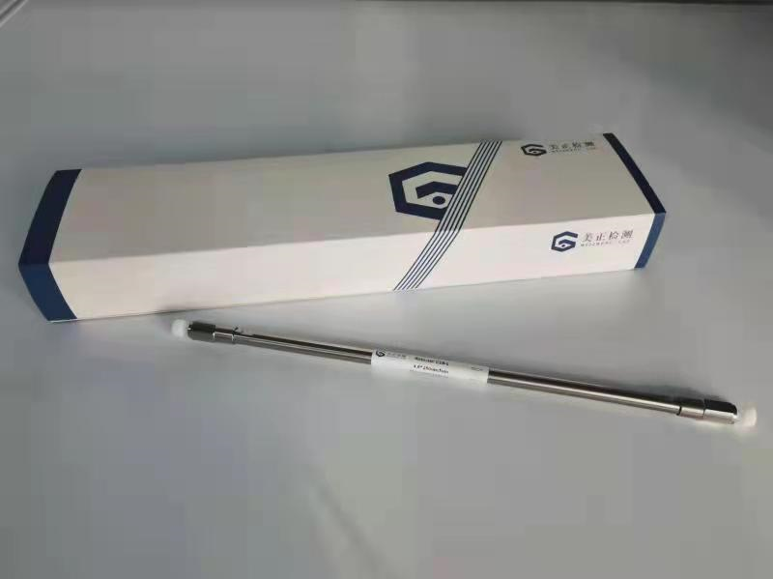



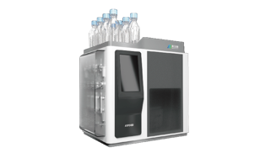







Laboratory Test Products
Sample preparation Consumables
Pre-treatment
Instrument
HPLC columns
Reference Materials
Immunoaffinity
Column (IAC)
Solid reference materials
Liquid reference materials (single&mixed)
Immunoaffinity
Column (IAC)
Accessories
ASPE 480
Immunoaffinity and
Solid Phase Extract system
Solid phase extraction (SPE) column
Solid phase extraction (SPE) column
Matrix reference materials
Quality control materials
QuEChERS
QuEChERS
Membranes
Vials
Notes:
Matrix reference materials:基质空白样品（为了消除基质干扰的）

Slide 37





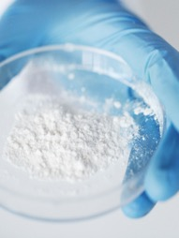
Third-party Detection Platform
Meizheng has established a high standard third-party testing physical and chemical laboratory, chromatography laboratory and spectrum laboratory, and has passed the CNAS laboratory accreditation and CMA qualification, ensuring the scientificity and accuracy of the test results.
Mycotoxins detection
Heavy metal detection
Pesticide and veterinary residues detection
Nutrients detection
Toxic and hazardous substances detection
General
component analysis
Grain, feed
Grain, oil and seafood
Vegetables, fruits, grain and oil, feed, meat, eggs, seafood and dairy products
Dairy products
Vegetables, fruits, grain and oil, feed, meat, eggs, seafood and dairy products
Grain and oil, dairy products

Slide 38
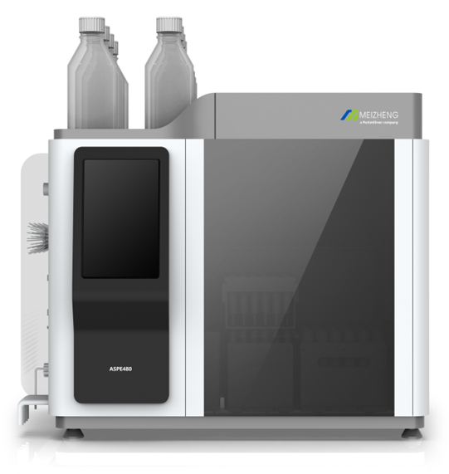
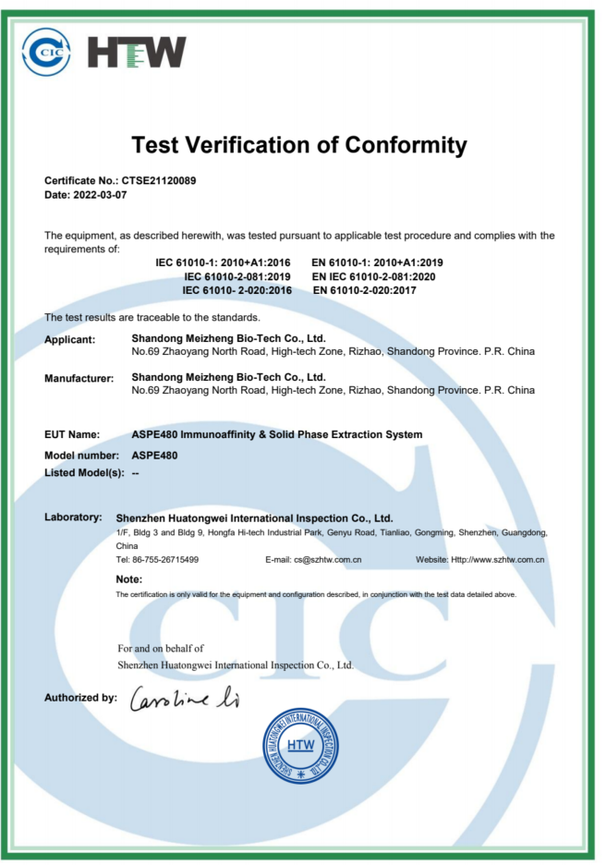
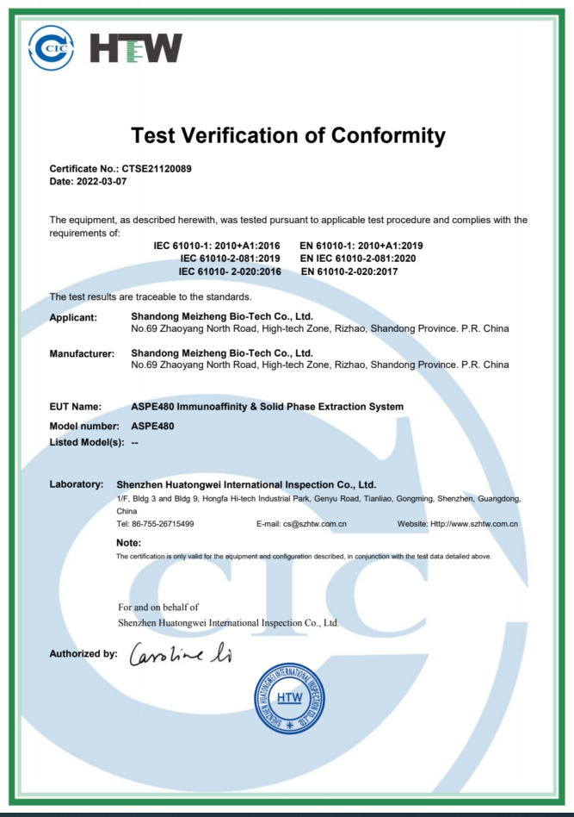
Key Products - ASPE480
CE Certification
ASPE480 Immunoaffinity & Solid Phase Extraction System is a multifunctional pre-treatment instrument which can use immunoaffinity chromatography and solid phase extraction, achieving automatic process to remove cap, condition, load, wash and elute.

Slide 39
Key Products - IAC
Catalogue Number | Product Name | Product Properties | Specs | Matrix
HCM0125B | IAC for Aflatoxins B1,B2,G1,G2 | 300ng | 3mL,25T | Grain and oil, nuts, feed, herbs, tea, condiments, dairy products, etc.
HCM0225B | IAC for Aflatoxins Total B1,B2,G1,G2,M1,M2 | AFT B1/B2/G1/G2 300ng, AFT M1 100ng, AFT M2 100ng | 3mL,25T | Grain and oil, nuts, feed, herbs, tea, condiments, dairy products, etc.
HCM0325B | IAC for Aflatoxin B1 | 300ng | 3mL,25T | Grain, oil, feed, herbs, etc.
HCM0525B | IAC for Zearalenone | 2000ng | 3mL,25T | Grain, feed, etc
HCM0625B | IAC for Deoxynivalenol | 2000ng | 3mL,25T | Grain, oil, feed, alcohol, condiments, etc.
HCM3025B | IAC for Deoxynivalenols (DON/3-ADON/15-ADON) | DON 2000ng, 3-ADON 1000ng, 15-ADON 2000ng | 3mL,25T | Grain, oil, feed, alcohol, condiments, etc.
HCM0725B | IAC for Ochratoxin A | 100ng | 3mL,25T | Grains, peanuts, feed, alcohol, condiments, herbs, etc.
HCM0825B | IAC for Fumonisins B1,B2,B3 | 5000ng | 3mL,25T | Grain, oil, feed, etc
HCM0925B | IAC for T-2 Toxin | 2500ng | 3mL,25T | Grain, oil, feed, etc
HCM2025B | IAC for T-2,HT-2 Toxin | 2000ng | 3mL,25T | Grain, oil, feed, etc
HCM2125B | IAC for Citrinin | 500ng | 3mL,25T | Grain, red koji products, etc.
HCM2225B | IAC for Sterigmatocystin | 600ng | 3mL,25T | Grain, etc
Multiple-in-one Mycotoxins Immunoaffinity Columns
Various combination: 2 in 1, 3 in 1, 4 in 1, 5 in 1, 6 in 1

Slide 40
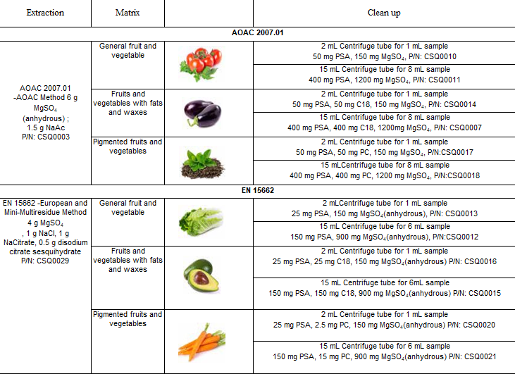
Key Products - Sample Preparation
QuEChERS
SPE Column
Part No. | Product Name | Description | Specification
CSS0019 | PolyPlus HLB | Hydrophilic-lipophilic balanced reversed phase sorbent | 500mg/3mL, 50/PK
CSS0020 | PolyPlus HLB | Hydrophilic-lipophilic balanced reversed phase sorbent | 500mg/6mL, 30/PK
CSS0028 | PolyPlus MAX | Mixed-mode anion exchange for acids | 500mg/6mL, 30/PK
CSS0124 | PolyPlus MAX | Mixed-mode anion exchange for acids | 500mg/3mL, 50/Pk
CSS0024 | PolyPlus MCX | Mixed-mode cation exchange sorbent for bases | 500mg/6mL, 30/PK
CSS0031 | PolyPlus WAX | Weak anion exchange mixed-mode sorbent for strong acidic compounds | 500mg/6mL, 30/PK
CSS0034 | PolyPlus WCX | Weak cation exchange mixed-mode sorbent for strong basic compounds | 500mg/6mL, 30/PK
CSS0148 | PolyPlus HLB-2 | Hydrophilic-lipophilic balanced reversed phase sorbent | 500mg/3mL, 50/Pk
CSS0149 | PolyPlus HLB-2 | Hydrophilic-lipophilic balanced reversed phase sorbent | 500mg/6mL, 30/Pk
CSS0157 | PolyPlus MCX-2 | Mixed-mode cation exchange sorbent for bases | 500mg/6mL, 30/Pk

Slide 41










Reference Customers
Notes:
Cargill: MZ Key Account in China,
Yili: world top20 dairy producer, no. 5
Mengniu: world top 20, no. 9
ALS: validated MZ IAC with flying colors
Lincosa
Gloria Peru – main supplier of BTS kits
Agrolab in Morocco – dairy kits
Lactalis, Muller, Nestle, etc. on the way…

Slide 42

Meizheng, Committed to Safeguarding Global Food Health,
Can Provide You Integrated Food Testing Solutions from Farm to Table!

Slide 43


Thank You
For Your Time

